Slide 1
Spring Chinook Salmon in the Portland Metro Area
Jenny Kaylor, Josh Williams, Jay Hastings, Erica Fisher , and Courtney Muhlbach

Slide 2
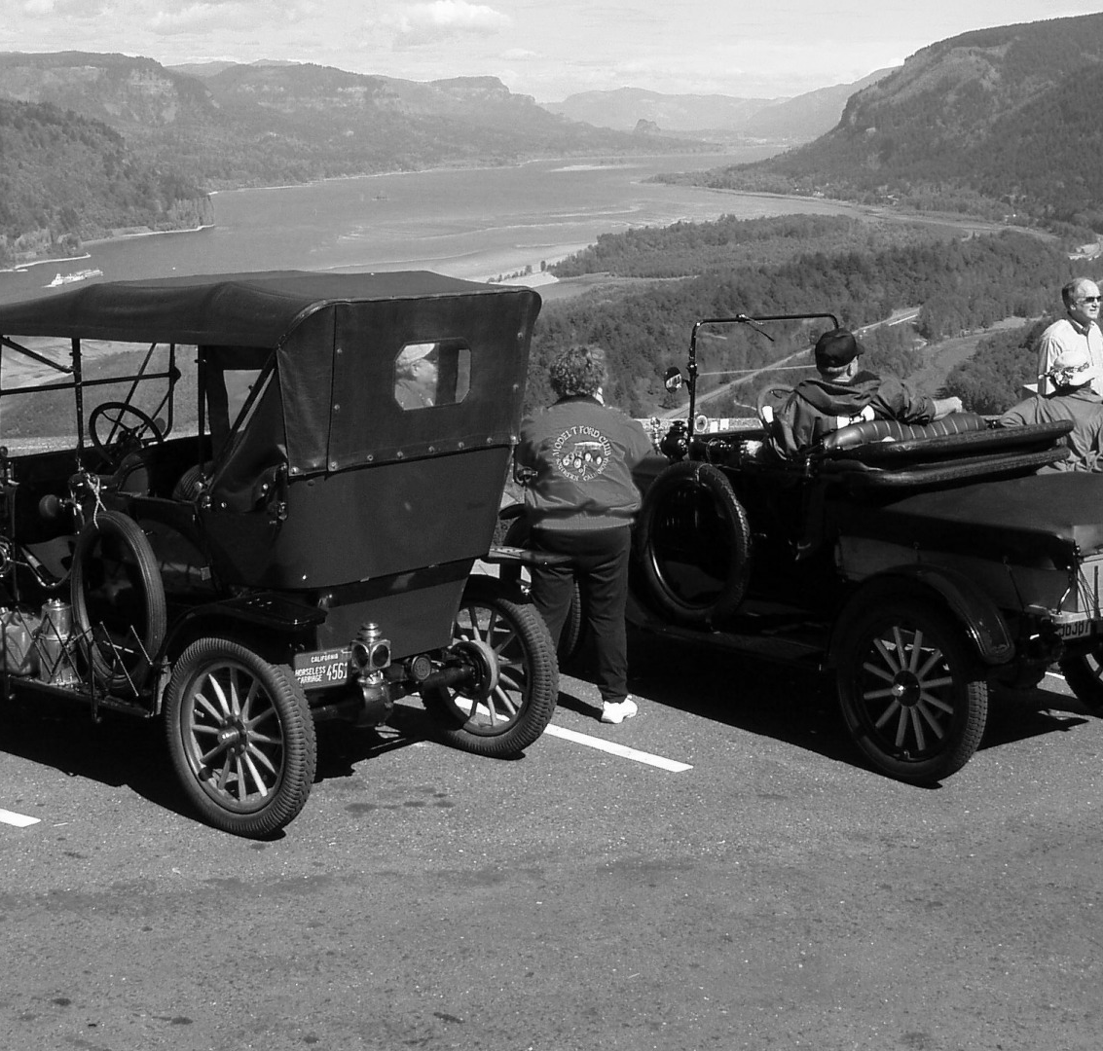
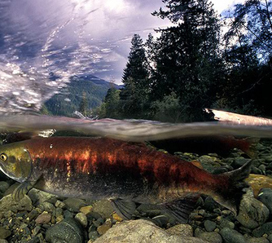
Background
Salmon
Rivers
Cities
Dams
Oh My!
Notes:
Salmon facts:
Salmon like a very narrow range of temperatures
The Columbia River is one of the world’s largest hydropower systems
There are over 450 dams throughout the entire Columbia River system
The Chinook salmon of the Columbia River has been classified as an endangered species
Many factors affect the water temperature/Snow pack/Population/Pollution/Gage
Young juvenile salmon or smolts seem to like warmer water, unless it is hot outside, then they seek cooler water
In the fall juvenile salmon move downstream to avoid colder water upstream
Spring chinook are even more sensitive than a lot of other fish
During the spawning migration, temperature is a critical environment factor. High water temps can delay or even halt fish migration
Spring Chinook like to spawn in May-June and the ideal temp is 40-50 degrees f
If the chinook salmon is shocked thermally (unideal temp) it will often be preyed upon by larger fish

Slide 3
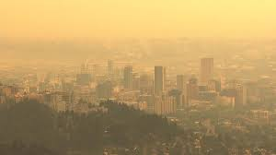
Hypothesis
Does urban growth have an affect on the salmon population?

Slide 4

Motivation and Summary: Spring Chinook Salmon vs. Water Relationship
Notes:
Our motivation was to find a correlation between the “2008-2019” water’s effect on the Native Chinook Salmon Populations in the “Lower Columbia” area during their migration cycle to spawn in the “Spring”.
*Lower Columbia is from the Bonneville and down, Willamette Falls included.

Slide 5


Questions Asked
Will Spring Chinook Salmon be here for our grandchildren?
What data do we have?
Notes:
What are the ideal water conditions for Chinook Salmon spring spawning habitat?
Were the temperatures met between the years of 2008-2020?
Is there a correlation between the Portland Metro population and the number of salmon?
We looked at the temperature surrounding the Bonneville dam and Willamette falls as well as the gage height.
We also looked at the oxygen levels but weren’t able to pull in more than one location.
We took a look at the snow pack as well.
The best places that we were able to find the data was the USGS (US Geological Survey), NRCS (Natural Resources Conservation Services), Columbia Basin Research (DART- Data Access in Real Time), and US Census.

Slide 6

Data Clean up and Exploration
Google misery
Too many sources – is it relevant data?
Data inconsistencies – so many formats
Making sure our shapes matched up – working with teams
Scrubbing, Scrubbing, Scrubbing
Notes:
The nature of the data on the web is there can be several false positives when searching through all the
different keywords.
- Many sites had great narritives but cited data wasn't consumable in the form we needed
It was important to us that we could find consistent and reliable data sources.
- We found many partial sources (like a dam was removed which lead to a partial dataset)
There were many sites where data mining would have been cumbersome because of the underlying format
(embedded in research papers or some static visualizations).
- Example Commercial Fishing site, which we decided against
Once we did find data that was easily queryable through the user interface working through the
shape and grain of data we wanted to select wasn’t made any easier by the 1990’s type web interfaces.
- Also in the data we found no reliable APIs were found, so we were stuck with CSVs
Then there was the problem who pulled what and what to decide was relevant and not relevant data sources
(was the source of the data close enough to the locations we were interested in).
- Josh and I on more than one occassion pull data from the wrong location and or for the wrong time period
Lastly, there were plenty of troubles with the data with regards to format and having consistent data points,
this did lead us to dropping a few data points along the way.
- We were luck in this regard since the number of data points were not significant enough to have any effect on the outcome
We also needed to be careful since our data way time sensitive in the way salmon migration timings work.
- Since the spring chinook salmon run is from March to April we needed to make sure any data used reflected that time period

Slide 7
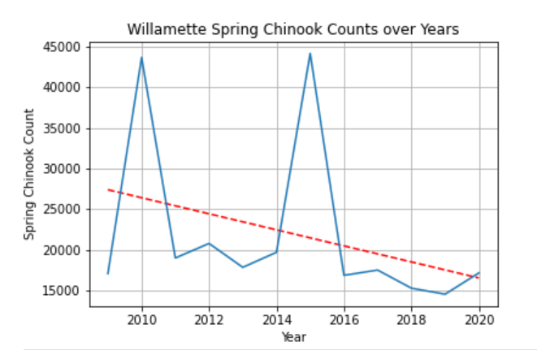
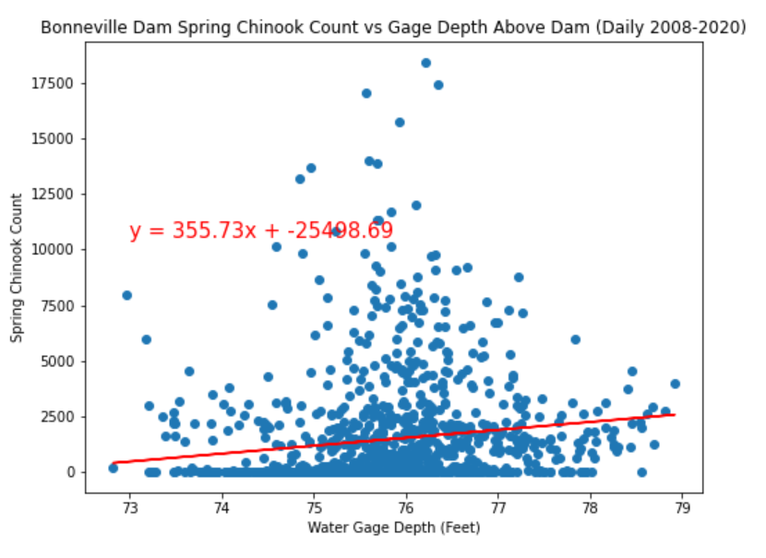
Data Analysis
Notes:
Salmon Count (Jenny)
Bonneville Above Dam (Courtney/Jenny)
-Temperature and Gage Height
Bonneville Below Dam (Jay)
-Temperature and Gage Height
Willamette Falls (Josh)
-Temperature and Gage Height
Portland Metro Population (Erica)

Slide 8
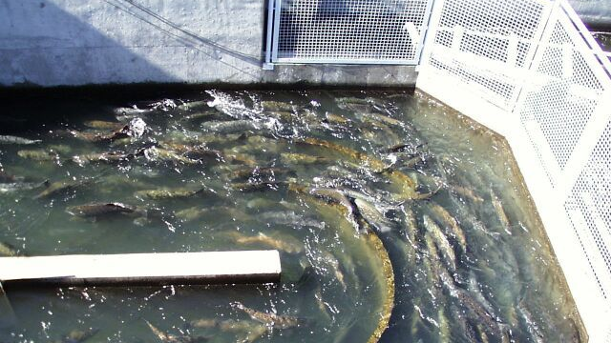
Post Mortem
Notes:
In all, we would have liked to have more time to research available data for plausible causes to the chinook salmon decline.
In consideration for future study, we would recommend comparisons to other dams in different states that the spring chinook salmon populate. We would also like to look into market trends for commercial use of salmon.

Slide 9
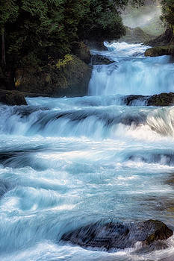
Questions?

Slide 10
Backup Slides

Slide 11
Data Sources
USGS (US Geological Survey)
https://maps.waterdata.usgs.gov/mapper/index.html
https://waterdata.usgs.gov/usa/nwis/uv?site_no=453845121562000
https://waterdata.usgs.gov/usa/nwis/uv?site_no=14128600
https://waterdata.usgs.gov/usa/nwis/uv?site_no=14128870
https://waterdata.usgs.gov/usa/nwis/uv?site_no=453630122021400
https://waterdata.usgs.gov/usa/nwis/uv?site_no=14211720
NRCS (Natural Resources Conservation Services)
https://wcc.sc.egov.usda.gov/nwcc/snow-course-sites.jsp?state=OR
Columbia Basin Research (DART- Data Access in Real Time)
http://www.cbr.washington.edu/dart/query/adult_daily
US Census
https://data.census.gov/

